Slide 1
Ergo / Indoor Air Quality
Call or email
Kelly Bergeron
IH Manager
bergerkc@mailbox.sc.edu
Cell 803-7606243

Slide 2
Stretch and Flex

Slide 3
Disclaimer
All stretches should be performed in the manner described. Hold each position at the point of comfortable stretch for 10 seconds. Employees with pre-existing conditions or past injuries should discuss this program with their personal physician or the occupational health nurse before participating. If you feel discomfort while stretching, STOP and report the discomfort to the wellness specialist in your area.

Slide 4
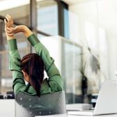
Why Stretch?
Prevent injury and promote better health
Increase flexibility
Increase circulation
Prepares joints, muscles, tendons, and nerves for activity

Slide 5
What is Flexibility?
Flexibility is having adequate muscular length to allow joints to move efficiently
Good flexibility allows body parts to move without compressing tissues or nerves

Slide 6
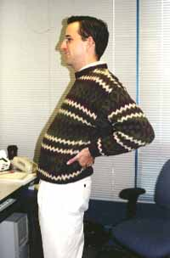
Why is Flexibility Important?
As you perform activities at home or work, you assume different postures to get things done
Adequate muscular flexibility helps get the job done more efficiently

Slide 7
Why is Flexibility Important?
Breaks or changes in work tasks, coupled with various exercises and stretching, can provide you with the time needed for stressed muscles and tendons to recover to their "normal" state, and also help fight injuries that accumulate after intensive, long-term keyboarding work. As for any exercise, remember that if you have any pre-existing condition that you believe could be negatively impacted by these stretches, consult a trainer or doctor before beginning them.

Slide 8
Proper Stretching
Gently lengthens a muscle prior to exertion
Should feel a mild “stretch”, NEVER pain
Hold for 10-30 seconds
Do not hold your breath
Do not bounce
Too much force is counterproductive

Slide 9
When to Stretch?
Start of shift
Throughout the day
During lunch/dinner
During break
While in meetings
During down time
Anytime your body says you need it!

Slide 10
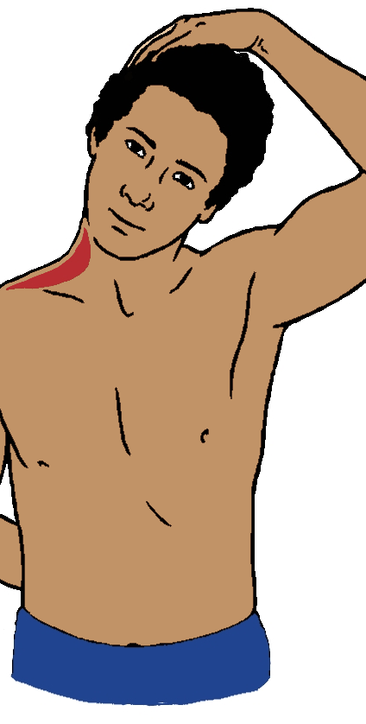
Lateral Neck Stretch
Place one hand behind back and the other on top of head
Gently pull head to side until gentle stretch is felt on side of neck
Hold 10 seconds
Repeat with other side

Slide 11
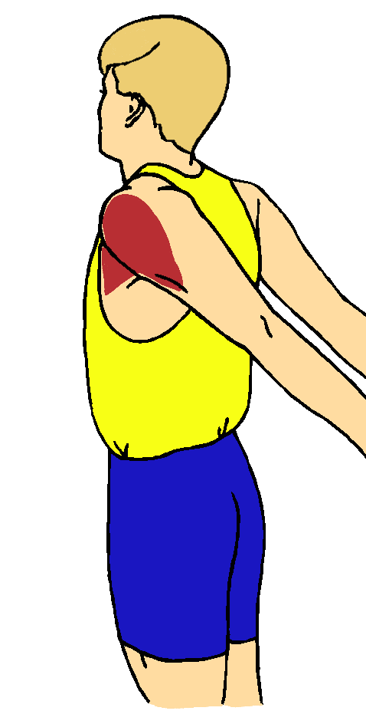
Chest Bicep Stretch
Clasp hands behind back and gently reach away from back
Gentle stretch should be felt in front of shoulders and chest
Hold 10 seconds

Slide 12
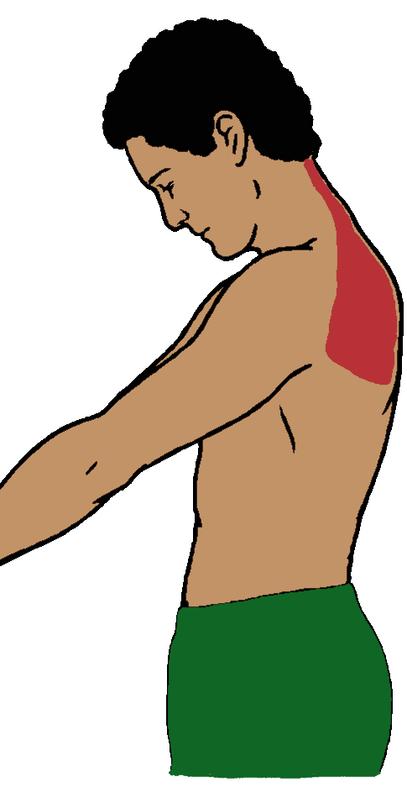
Upper Back Stretch
Clasp hands together in front
Reach away from your body
Gently bend neck down
Stretch should be felt in upper back and lower neck
Hold 10 seconds

Slide 13
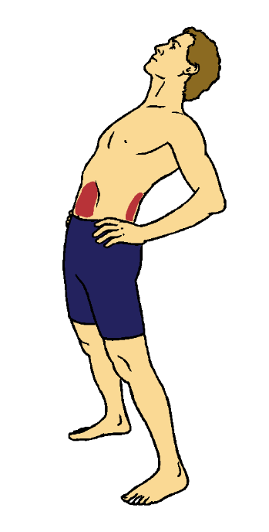
Back Extension Stretch
Place hands on hips and gently bend torso backwards
Stretch should be felt in front of torso and possibly in low back
Hold 10 seconds

Slide 14
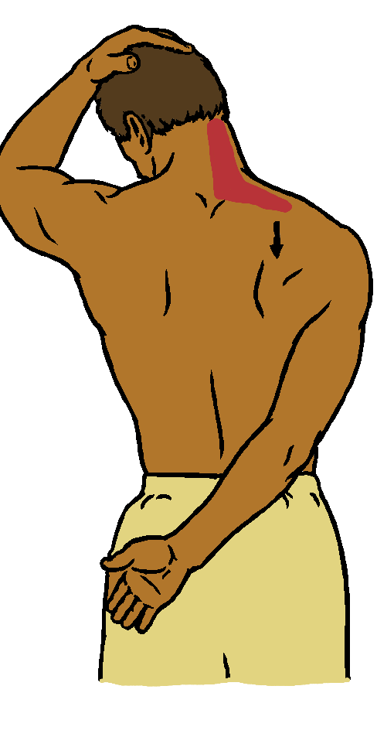
Neck Shoulder Stretch
Place one arm behind back and other on top of head
Gently pull head forward and towards underarm until stretch is felt in back and/or side of neck
Hold 10 seconds
Repeat with other side

Slide 15
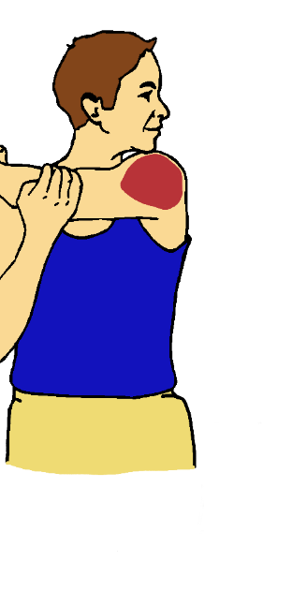
Shoulder Stretch
Gently pull arm across body while looking over shoulder
Hold 10 seconds
Repeat with other side

Slide 16
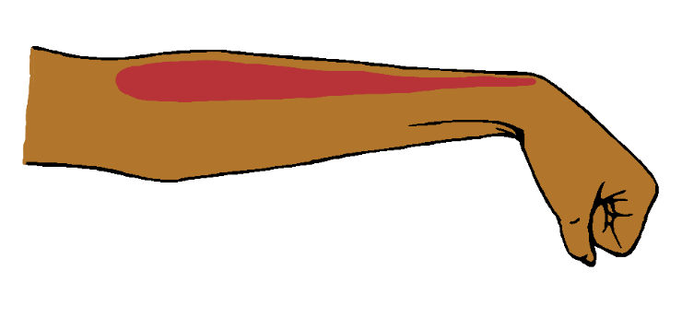
Forearm Stretch
Palms down, make a fist and flex the wrists down while keeping the elbows straight
Hold 10 seconds

Slide 17
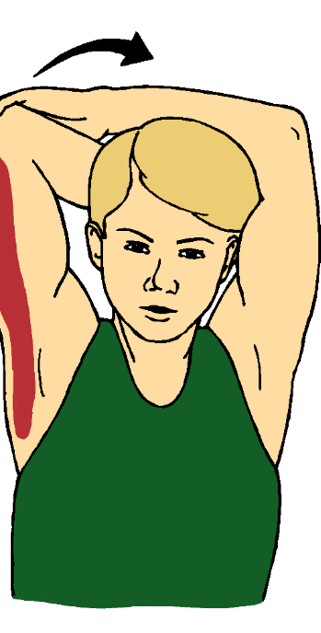
Tricep Stretch
Grasp opposite elbow overhead and gently pull towards head
Hold 10 seconds
Repeat with other side

