Slide 1
CTE Resources & Support
Notes:
30 minutes
Overview of Center for Teaching Excellence (CTE) Resources/ Instructional Design Support Overview
Casey: Will focus on CTE Resources and highlight the ID Team and their resources, and follow up resources

Slide 2
CTE Resources
Workshops
Programs
Special Events
Notes:
(5 minutes)
Workshops: We offer a variety of in-person and virtual workshops on a variety of topics and skills. You can check out our calendar of events to see what works for you. We also post many of our webinars on our YouTube channel.
Programs: We have certificates of completion for groups of workshops, and short courses on teaching online and technology for documented professional development. We also have learning communities for large sections and virtual environments.
Special Events: Our special events are one time or yearly events on particular topics or opportunities. We are currently planning for our annual teaching symposium, Oktoberbest, that will be held in-person on Friday, October 25.
Workshops: https://www.sc.edu/about/offices_and_divisions/cte/workshops/index.php
Programs: https://www.sc.edu/about/offices_and_divisions/cte/programs/index.php
Special Events: https://www.sc.edu/about/offices_and_divisions/cte/special_events/index.php

Slide 3
Instructional Design Support
Consultations
Course Development
Classroom Observations
Syllabus and Course Review
Notes:
The Center for Teaching Excellence has a team of professional educators that can provide individual consultations tailored to your personal teaching needs and provide you skills, resources, and one-on-one support to achieve your goals. We utilize evidence-based best practices to help you enhance your teaching and create effective learning experiences.
We can help with things such as course planning, syllabus review, understanding issues at USC, or anything else related to teaching! You can submit a request form through the link in thee chat or email us directly!
Link to consultations form: https://www.sc.edu/about/offices_and_divisions/cte/consultations/index.php

Slide 4
Teaching Resources
Notes:
Our website has a variety of teaching resources. I’m going to highlight a few that could be helpful as long with some things to consider as you get ready for the semester!
General Teaching Resources Link: https://www.sc.edu/about/offices_and_divisions/cte/teaching_resources/index.php

Slide 5
Blackboard
Webinars
Resource Page
Course Template
Notes:
CTE and eLearning Services (ELS) can booth help you make sure that you feel comfortable using our Blackboard Learning Management system and that it is organized in the way that will best support your students.
You can find Blackboard specific webinars and workshops on the CTE website. We also have a resources page with easy to access help and recorded webinars.
CTE also has a course template that you can use to get your Blackboard structure started. You can request this from an instructional designer or download from our website.
Links:
Webinars: https://www.sc.edu/about/offices_and_divisions/cte/teaching_resources/blackboard/blackboard_ucv_faq/index.php
Resource page: https://www.sc.edu/about/offices_and_divisions/cte/teaching_resources/blackboard/
Template: https://www.sc.edu/about/offices_and_divisions/cte/teaching_resources/blackboard/docs/cte_ucv_template_import_instructions.pdf

Slide 6
Grading & Assessment Toolbox
No set numerical scale
+ yes! – no!
Final grades outside Blackboard
Notes:
Grading & assessment can be one of the more challenging aspects of teaching! Try your best to create authentic assessments that help students demonstrate the skills that they have been learning in your course. Feel free to explore our grading and assessment toolbox for more resources.
If you are new to USC, here are a few things to be aware of:
USC has no institutional scale to determine the letter grade in a course. An A could be 90-100% or 92% or whatever. It is up to the instructor. Check with your department to see if they use a common scale. Whatever you choose, make sure to communicate those expectations clearly to students. The are some examples on our syllabus resources page.
USC uses +s but no –s. So, A, B+, B, C+, and do on!
Final grades are submitted to the registrar’s site on Banner (or my.sc.edu), not through Blackboard. Once your final grade calculations are complete, you will need to enter them in that system.
Links:
Grading toolbox!: https://www.sc.edu/about/offices_and_divisions/cte/teaching_resources/course_design_development_delivery/grading_assessment_toolbox/
Final grades tutorial: https://www.youtube.com/watch?feature=shared&v=dvdoQFnZnIk

Slide 7
Online Teaching Toolbox
Focus on engagement & active learning
Resources & quality standards
Notes:
If you are teaching online, check out our online teaching toolbox that has a lot of different resources.
As you plan for online, make sure to emphasize active opportunities for students to be engaged including online activities, content checks, projects, or even group work.
Our resources include ideas for that as well as online quality standards that can help you to assist greater navigation and engagement for you and your students.
If you would like help planning for online or solving a particular question, makes sure to request a consultation with one of our instructional designers!
Links:
Online Teaching Toolbox: https://www.sc.edu/about/offices_and_divisions/cte/teaching_resources/course_design_development_delivery/online_teaching_faculty_toolbox/
QSOC: https://www.sc.edu/about/offices_and_divisions/cte/teaching_resources/course_design_development_delivery/online_teaching_faculty_toolbox/qsoc/index.php
Consultations: https://www.sc.edu/about/offices_and_divisions/cte/consultations/index.php

Slide 8
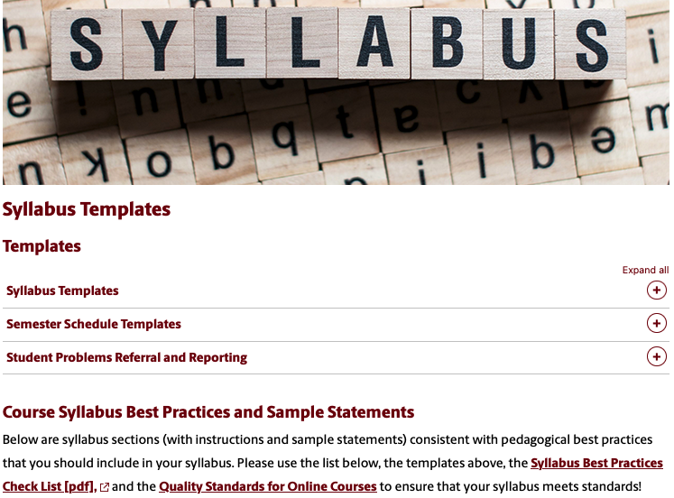
Syllabus Templates
Templates
Checklist
Example statements
Notes:
The syllabus is your plan for the semester, the primary method of communicating your course design and policies to your students and introducing them to the course, to the subject matter, and to YOU! It is also required for institutional and accreditation purposes.
The CTE website has word document(s) that you can use to start your syllabus and edit to fit your purposes.
We also have a checklist of best practices if you want to use that to write or review your syllabus.
Our sample syllabus templates can be used to update an existing syllabus or if you are writing from scratch.
The ID team can answer any syllabus questions or review your syllabus for you!
Links:
Syllabus page!: https://www.sc.edu/about/offices_and_divisions/cte/teaching_resources/syllabus_templates/index.php
Consultations!: https://www.sc.edu/about/offices_and_divisions/cte/consultations/index.php

Slide 9
Questions?
Center for Teaching Excellence
Thomas Cooper Library, Suite 511
803-777-9948
cte@sc.edu

